Slide 1
Brand hate: A systematic literature review and future research
agenda
Abhishek Yadav (Doctoral Scholar)
Indian Institute of management, Kashipur, India
Dr. Somnath Chakrabarti, Ph.D.
Indian Institute of management, Kashipur, India
7th International Consumer Brand Relationships Conference

Slide 2
Yadav, A., & Chakrabarti, S. (2022). Brand hate: A systematic literature review and future research agenda. International Journal of Consumer Studies, 00, 1–28. https://doi.org/10.1111/ijcs.12772

Slide 3
Introduction
Review of Literature
Thematic Analysis
Conceptual Framework
Future Research
Hate
Hate is a complex emotion and psychology researchers have diverse opinions about it being a primary emotion (Arnold, 1960).
Even though some researchers consider it a simple emotion (Fehr and Russell, 1984; Shaver et al., 1987; Storm and Storm, 1987), majority of them think that hate is a compounded form of other primary and/or secondary emotions.
Anger/Fear
Anger
Disgust
Disgust
Contempt
Kemper (1987)
McDougall (2001)
Plutchik (1991)
Sternberg (2003)
Anger
Anger
Fear
Fear
Disgust

Slide 4
Introduction
Review of Literature
Thematic Analysis
Conceptual Framework
Future Research
Hate
Hate is one of the strongest negative emotions that individuals can experience.
Psychology researchers (Ito et al., 1998; Rozin and Royzman, 2001) have identified the relatively higher significance of negative emotions such as hate in shaping the behaviours of individuals in comparison to positive emotions.
Therefore, decision-makers give substantial importance to understanding the negative experiences of individuals (Kanouse, 1984).
Despite this, in comparison to research on positive emotions such as brand love (e.g., Albert and Merunka, 2013; Batra et al., 2012; Carroll and Ahuvia, 2006), brand attachment (e.g., Park et al., 2008; Thomson et al., 2005), and brand loyalty (e.g., Bloemer and Kasper, 1995; Chaudhuri and Holbrook, 2001), research on negative brand relationships such as brand avoidance (e.g., Lee et al., 2009; Rindell et al., 2013), anti-branding (e.g. Krishnamurthy and Kucuk, 2009; Kucuk, 2008), brand dislike (e.g. Dalli et al., 2006), and brand hate (e.g., Hegner et al., 2017; Zarantonello et al., 2016) is relatively scarce..

Slide 5
Introduction
Review of Literature
Thematic Analysis
Conceptual Framework
Future Research
Brand Hate
Brand hate as a construct was first conceptualized by Kucuk (2008) in academic literature in which he gave the theory of “Negative Double Jeopardy” to understand the motivation behind anti-branding websites.
Since then, researchers have considered brand hate as “Shame” (Johnson et al., 2011); “extreme form of dislike” (Romani et al., 2012); compound of intense negative emotions (Fetscherin, 2019; Kucuk, 2016; Zarantonello et al., 2016; Zhang and Laroche, 2020) etc.
Consumers can experience hatred towards a brand due to multiple internal and external factors.
Experience of such hatred will define an individual’s behavior towards the brand.

Slide 6
Introduction
Review of Literature
Thematic Analysis
Conceptual Framework
Future Research
Brand hate conceptualization
First academic conceptualization of ‘brand hate’ as a type of consumer-brand relationship defined it as antithetical to brand love (Caroll and Ahuvia, 2006).
Extreme negative affect
Anger +
Disgust +
Contempt
Brand hate emotion
Brand hate emotion
Shame
Unidimensional
Johnson et al (2011)
Bryson et al (2013)
Romani et al (2015)
Hegner et al (2017)
Kucuk (2018)
Brand hate
Caroll and Ahuvia (2006)
Romani et al (2012)
Kähr et al. (2016)
Zarantonello et al. (2016)
Fetscherin (2019)
Multidimensional
Dislike
Anger
Sadness
Worry
Embarrassment
Discontent
Anger
Frustration
Outrage
Hatred
Anger
Contempt/Disgust
Fear
Disappointment
Shame
Dehumanization
Anger
Disgust
Contempt

Slide 7
Introduction
Review of Literature
Thematic Analysis
Conceptual Framework
Future Research
Research objectives
To undertake a comprehensive literature review of assiduously selected peer-reviewed articles related to the concept of brand hate to understand and define various trends, perspectives, and research streams.
To explore theoretical foundations of brand hate literature to identify possible theoretical integration opportunities.
To propose a holistic conceptual framework for future research defining various cause-effect relationships of antecedents and outcomes of brand hate.
To determine potential future research directions that may stimulate research in this domain.

Slide 8
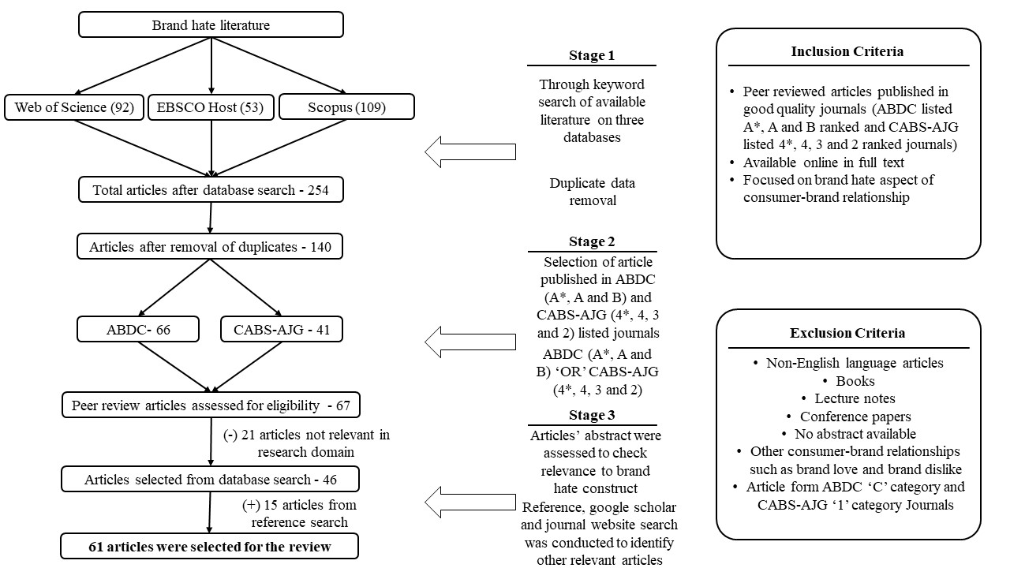
Introduction
Review of Literature
Thematic Analysis
Conceptual Framework
Future Research
Review methodology

Slide 9
Introduction
Review of Literature
Thematic Analysis
Conceptual Framework
Future Research
Overview
Even though companies have been investing in prevention of hate development in consumers towards their brand(s) for a long time, academia’s focused on this type of consumer brand relationship only by the end of 1st decade of 21st century with pioneering article of Kucuk (2008).
The articles selected for review were exploratory in nature with significant focus on identification of factors leading to brand hate generation and behavioral outcomes.
There is significant variation in conceptualization of brand hate construct among researchers.
Brand hate researchers have taken theoretical support from 15 widely accepted theories from diverse research domains of sociology, psychology, marketing, and consumer behavior to synergize into their research frameworks.
Triangular theory of hate (Sternberg, 2003) and social identity theory (Tajfel, 1974) were the most widely used theories.
Research on brand hate has exploded in the past couple of years as almost 50% of the articles selected for review were published in year 2019 and 2020.

Slide 10
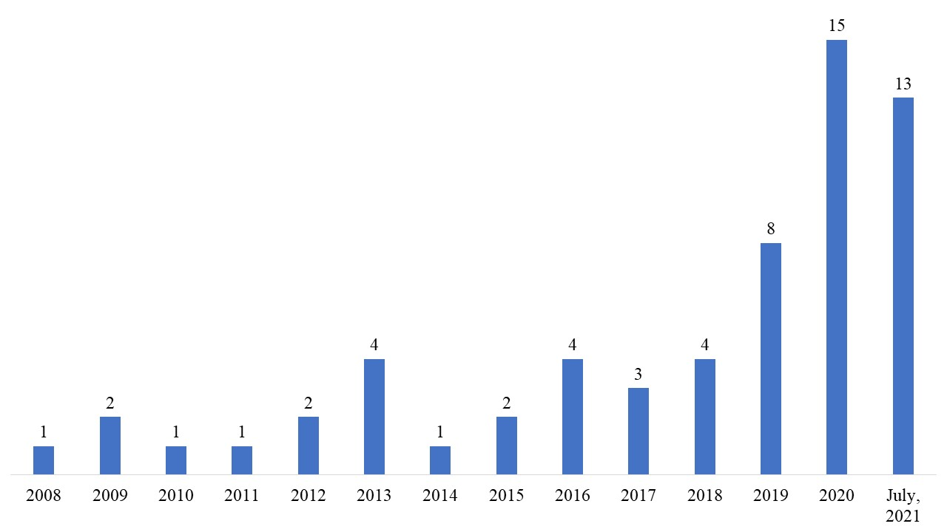
Introduction
Review of Literature
Thematic Analysis
Conceptual Framework
Future Research
Overview

Slide 11
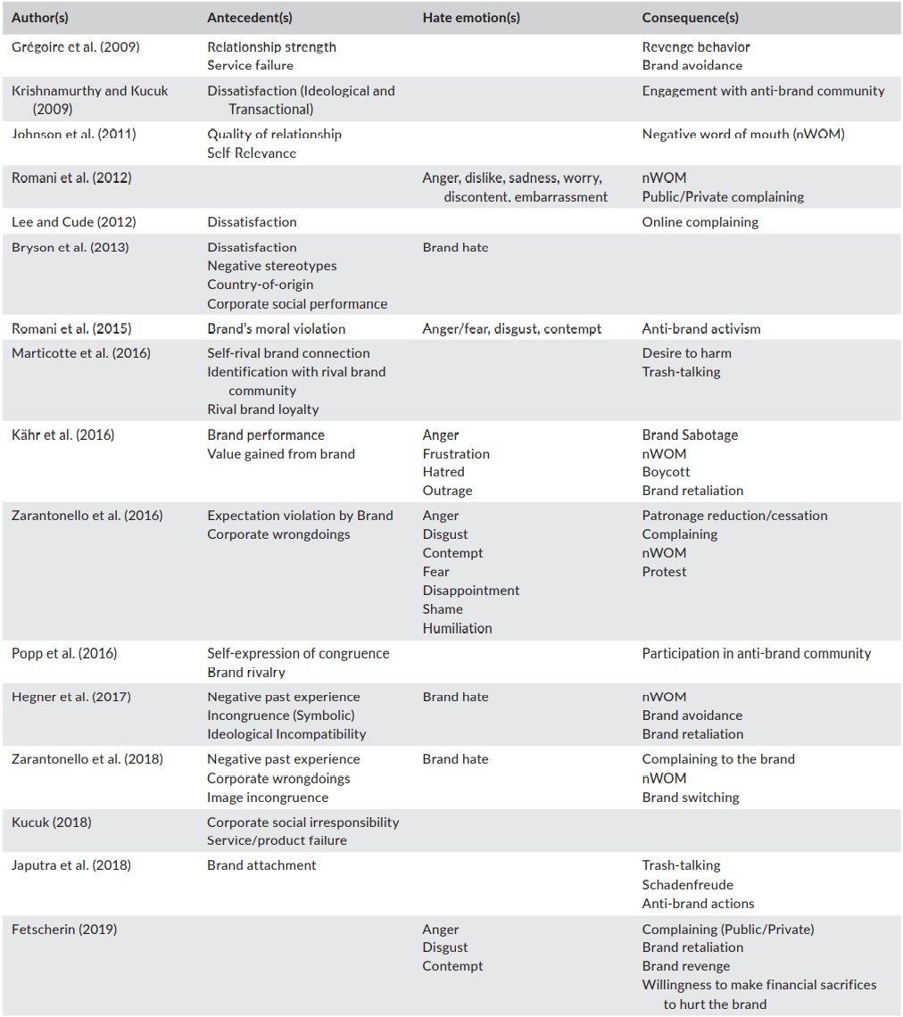
Introduction
Review of Literature
Thematic Analysis
Conceptual Framework
Future Research
Overview

Slide 12
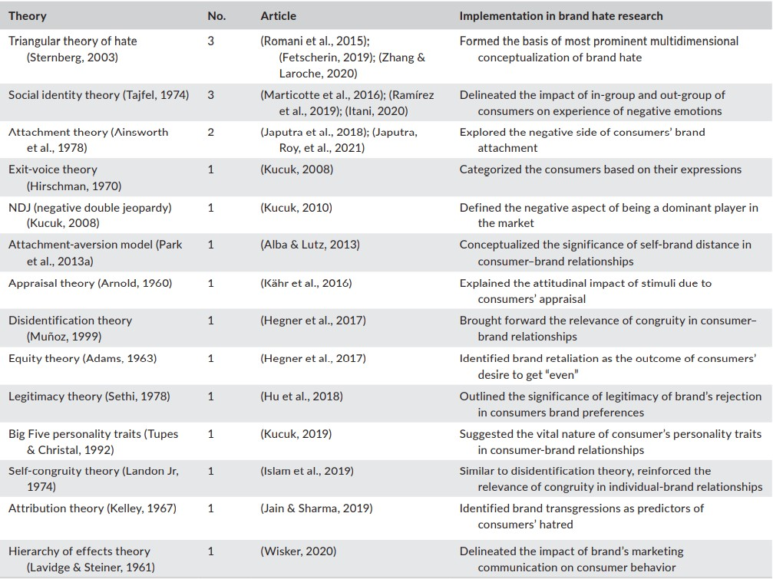
Introduction
Review of Literature
Thematic Analysis
Conceptual Framework
Future Research
Theoretical underpinnings

Slide 13
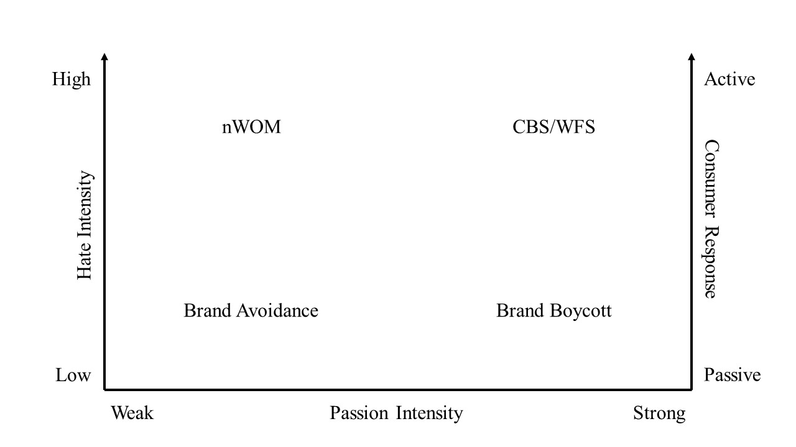
Introduction
Review of Literature
Thematic Analysis
Conceptual Framework
Future Research
Themes
Brand hate Stimuli:
Individual level
Brand Level
Environmental
Brand hate emotion
Brand hate behavior
Active
Passive

Slide 14
Introduction
Review of Literature
Thematic Analysis
Conceptual Framework
Future Research
Stimuli-Organism-Response (SOR) framework
Researchers have considered S-O-R framework as a comprehensive tool to understand customers’ cognitive and affective states and their subsequent behavior due to interaction with market stimuli (Buxbaum, 2016; Mehrabian and Russell. 1974; Vieira, 2013).

Slide 15
Introduction
Review of Literature
Thematic Analysis
Conceptual Framework
Future Research
Stimuli-Organism-Response (SOR) framework
Traditionally, S-O-R framework has been used in the context of store environment in which cues such as store lighting, color, smell etc. are considered as stimuli that influences the internal state of customers and subsequently their behavior (e.g., Eroglu et al., 2001; Koo and Ju, 2010; Mehrabian and Russell, 1974).
But researchers have used S-O-R framework in other contexts as well for example, to explain buying behavior, engagement, co-creation, purchase intention and so on.
Mckinney (2004) used this framework to establish a relationship between customers’ diverse internal motivation for online shopping and how significantly it impacts their satisfaction.
Peng and Kim (2014) used this framework to assess impact of internal and environmental stimuli on repurchase intentions in online shopping context
Likewise, Wu and Li (2018) explored the effects of marketing-mix components on loyalty in social commerce context using this framework where consumer value was defined as organism.

Slide 16
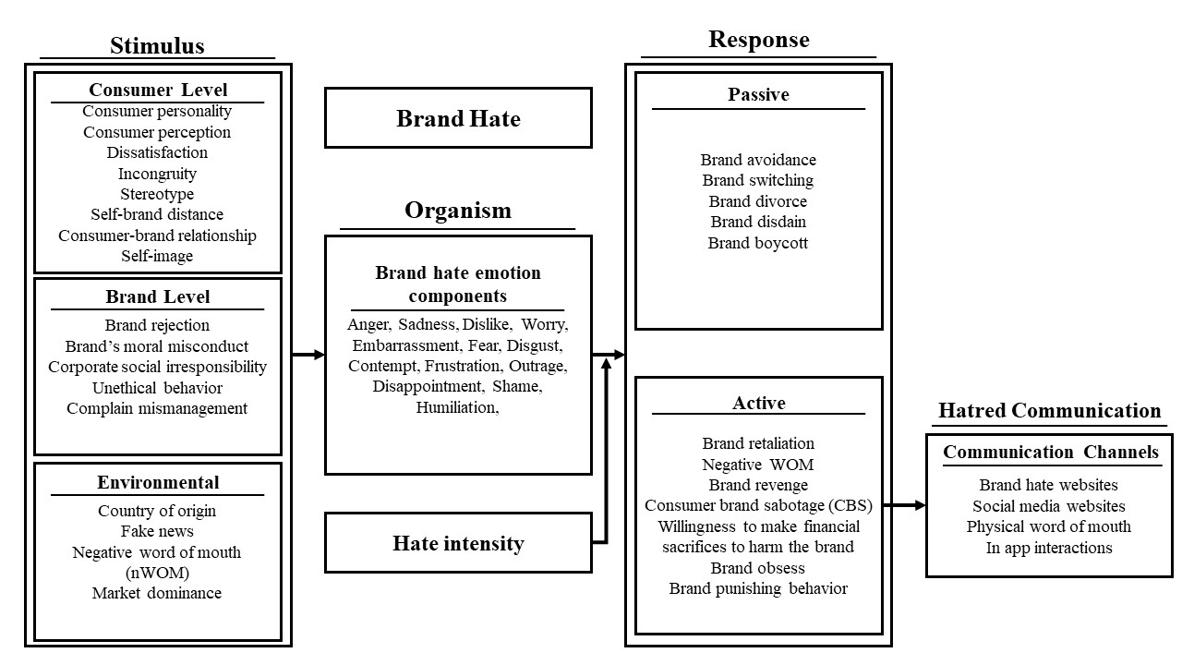
Introduction
Review of Literature
Thematic Analysis
Conceptual Framework
Future Research
Conceptual framework

Slide 17
Introduction
Review of Literature
Thematic Analysis
Conceptual Framework
Future Research
Future research agenda
TCCM framework
Theory:
Psychological field theory (Lewin, 1939)
Balance theory (Heider, 1958)
Personality traits
OCEAN model
Context:
Market
Less prestigious brands
Demography
Cross cultural setting
Industry specific
Characteristics:
Lack of bipolarity in love-hate relationship
Distinction of stimuli for different hate levels
Method:
Mixed-method approach
Machine learning-based analytical tools
Non-consumer haters

Slide 18
Thank You

